Slide 1
What does it look like at Fallston High School?

Slide 2
What is PLTW?
“Project Lead The Way provides transformative learning experiences for PreK-12 students and teachers across the U.S. We create an engaging, hands-on classroom environment and empower students to develop in-demand knowledge and skills they need to thrive.”
Engage
Empower
Inspire

Slide 3
Progression of Courses:
Introduction to Engineering Design (IED)
Principles of Engineering (POE)
Digital Electronics (DE)
ENGINEERING SPECIALIZATION COURSE – TBD
Aerospace Engineering
Environmental Sustainability
Civil Engineering & Architecture
Engineering Design & Development (EDD)

Slide 4
Frequently asked questions…
Application Process for PLTW?
Is it a Magnet Program?
No application necessary
If you are interested in the course, talk to your counselor
No, PLTW is a specialized program available at FHS for students who are enrolled in FHS!

Slide 5
How do I enroll in PLTW?
It’s simple, are you attending FHS in the Fall?
If YES, as an incoming 9th grader who is enrolled in at least Algebra II, you can select Introduction to Engineering on your Course Registration Sheet!

Slide 6
Intro to Engineering Design- Ms. J. Cummings
Units Covered:
Unit 1: Design & Problem Solving
Unit 2: Assembly Design
Unit 3: Thoughtful Product Design
Unit 4: Making things Move
Students will be using and learning:
CAD (Computer Automated Design) - Onshape
3D Printers
Sketching Skills- Orthographic & Isometric
Communication & Collaboration Skills in Small Groups
Engineering Notebook - keep sketches and whole group examples
Design Process
Putting together objects in CAD
3D Printing
Impactful designs
Positive or Negative Effects- thinking full circle
Animations in CAD

Slide 8
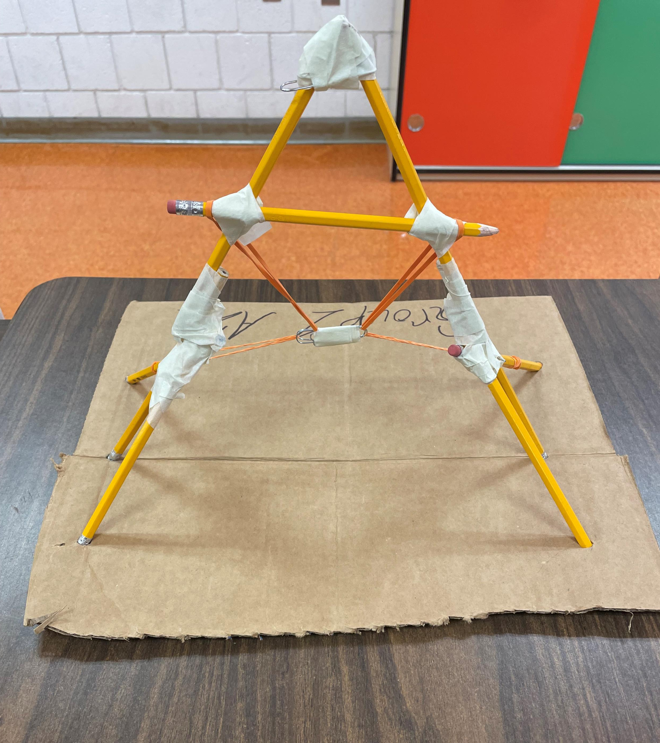
Instant Challenges:

Slide 9
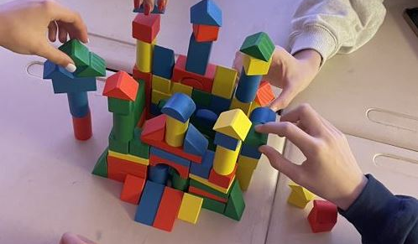
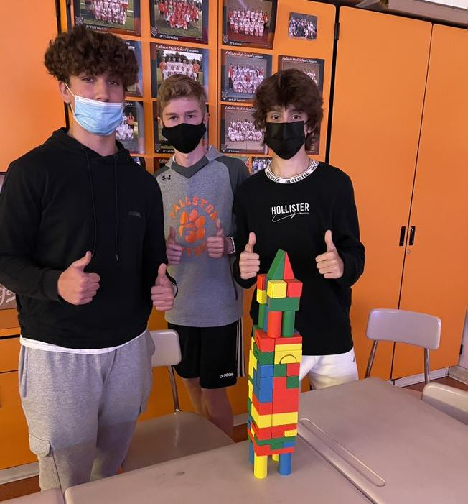
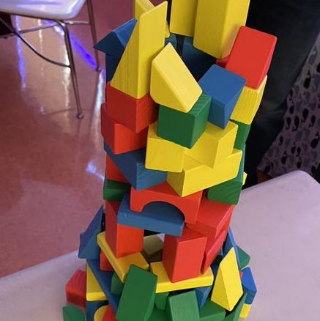
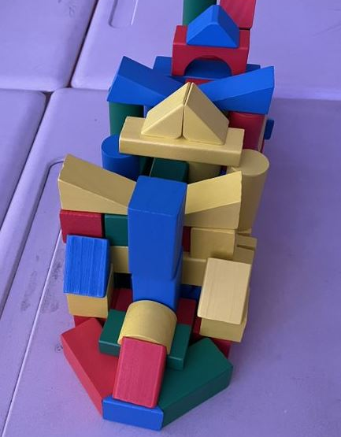
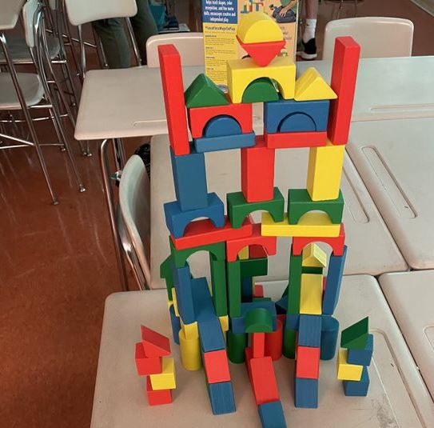
Communication Challenge
Each group had to use a box of 100 blocks to create a stable structure.

Slide 10
Principles of Engineering (POE) - Mr. Rychwalski
Unit 1 – Energy & Power​
Simple machines, circuits, thermodynamics, green energy​
Unit 2 – Materials & Structures​
Statics/forces, material stress/strain analysis, bridges/trusses​
Unit 3 – Control Systems​
Programming, robots, hydraulic/pneumatic power​
Unit 4 – Math Tools & Linear Motion​
Statistics, numbers, accelerated one/two dimensional kinematics​

Slide 11
POE vs IED
More math, equations/formulas & problem solving
More hands-on building/projects (robots/machines/circuits)
More computer programming, product testing and debugging​
Less computer aided designing/drafting​
Use of Eng. Notebook as a portfolio (designs, ideas, calculations, etc.)​

Slide 12
What is coming next…
Digital Electronics- Fall of 2022
Teacher: Mr. Chatterton
Engineering Specific Course – Fall of 2022
Teacher TBD
Engineering Design & Development – Fall of 2023
Teacher: Ms. J. Cummings

Slide 13
Questions about PLTW & Intro to Engineering?
Email: Ms. Cummings @ jacquelyn.cummings@hcps.org

Slide 14
Questions about Principles of Engineering?
Email: Mr. Rychwalksi @ edward.rychwalski@hcps.org

